Slide 1
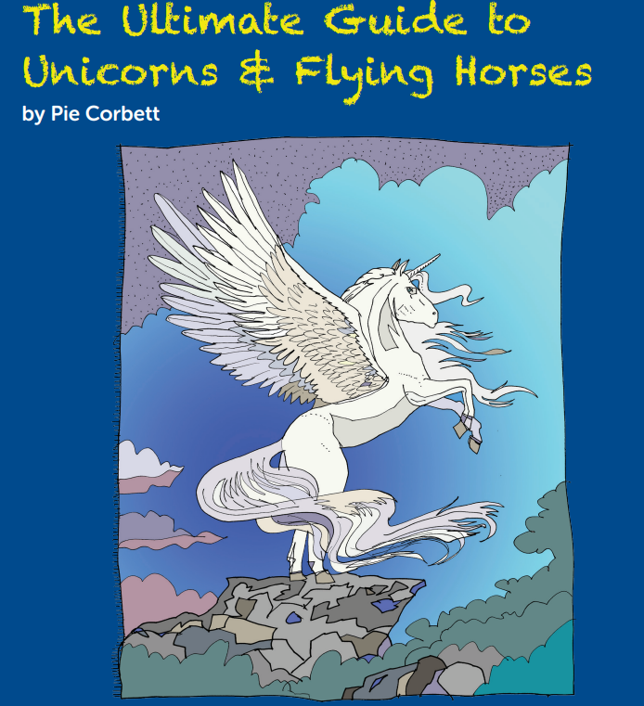

Slide 2
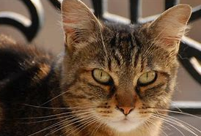
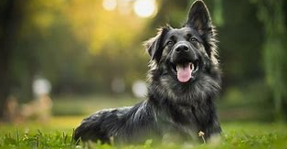
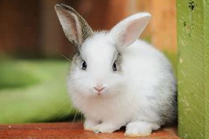
Cold Task
Write a fact file about an animal of your choice that you know well.
Which fact files have you already read?
What features do you already know?
How will it be presented?

Slide 3
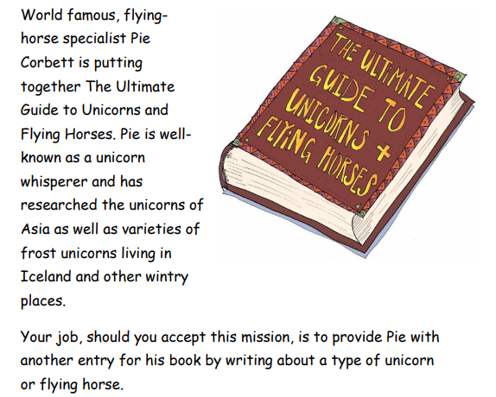
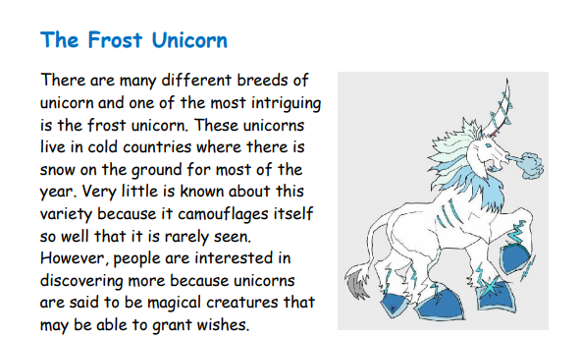

Slide 4
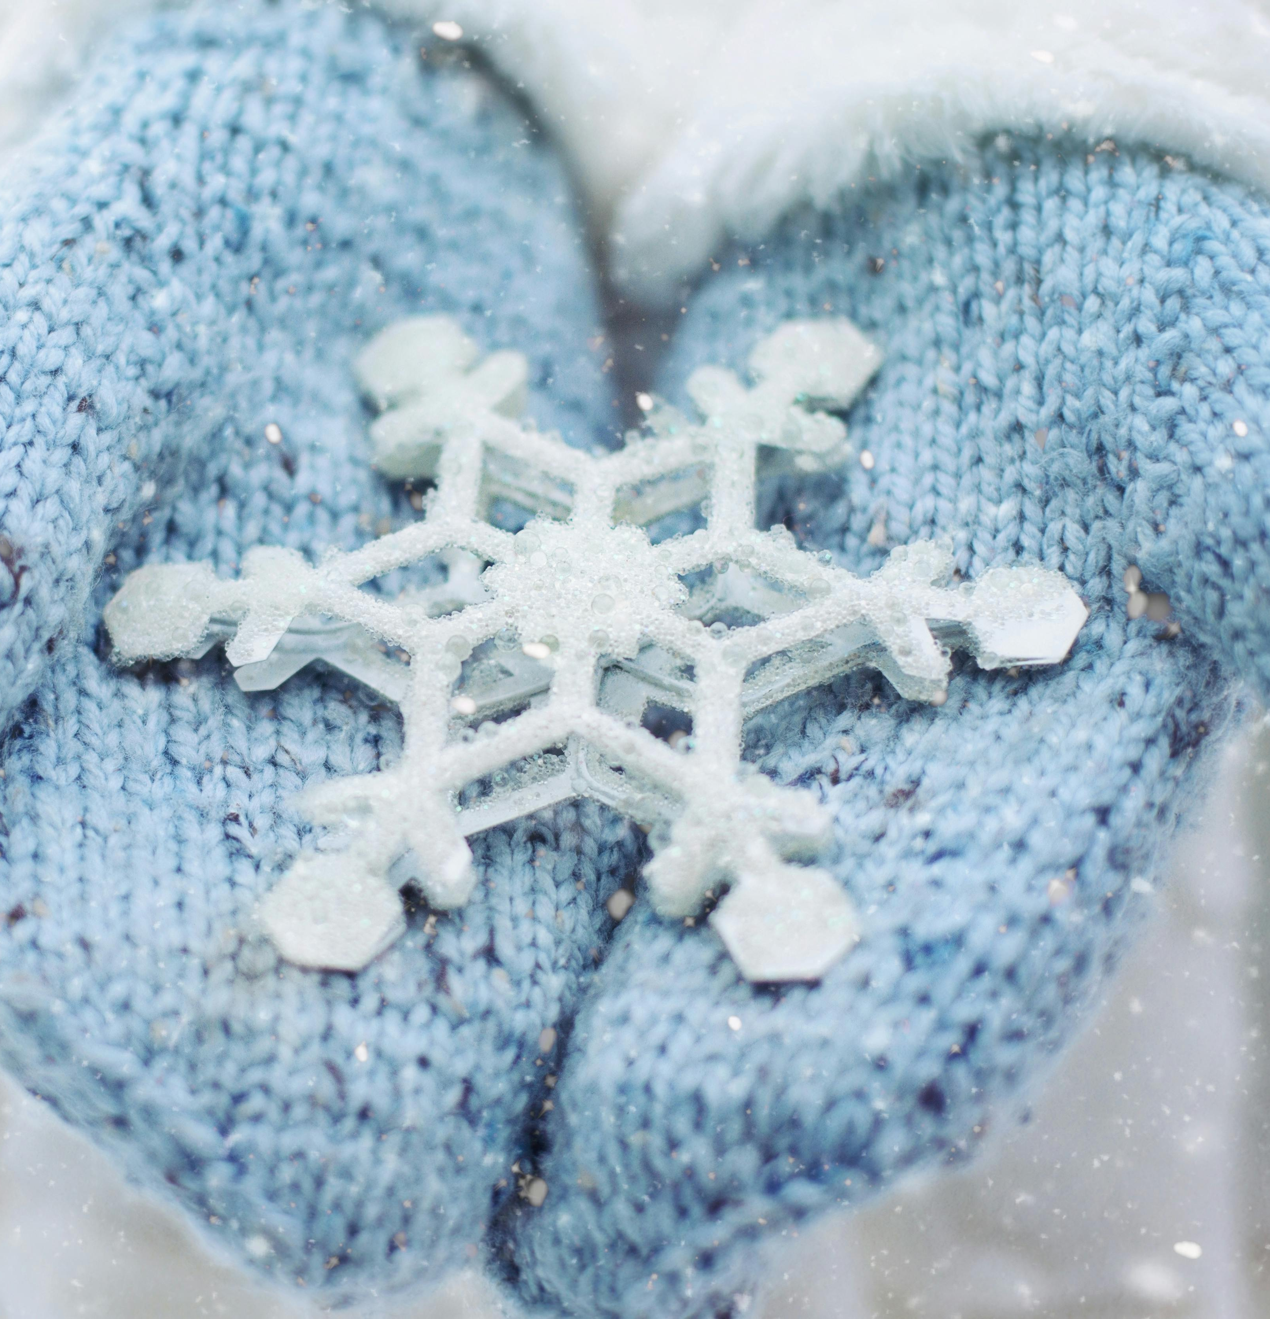
Would you be able to recognise a frost unicorn if you saw one? In fact, they are very similar to the large majority of unicorns. Like most unicorns, they have a long horn, the body of a horse and excellent eyesight. Typically, they are an amazing snow-white colour which glitters as their hair catches the sunlight. However, a few have been spotted which are a frost-blue colour with tinges of green in their mane. This helps them to blend in amongst forest vegetation. Furthermore, they have extraordinary teeth made of diamonds. Curiously, their tails consist of molten-silver hair which is stronger than steel. The main feature of the frost unicorn is that it can freeze anything that it touches and this is often used as a form of defence. Amazingly, they scatter flakes of snow-glitter as they move along. From a distance, they appear to be rather like a small, glowing snowstorm. They are almost indistinguishable from a Pegasus.

Slide 5
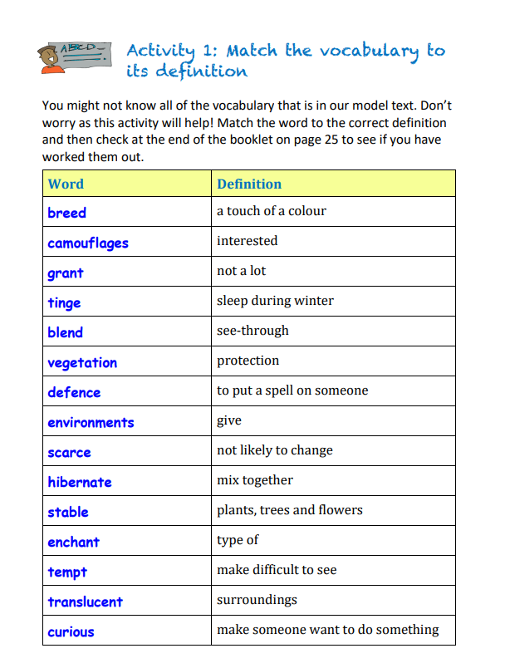
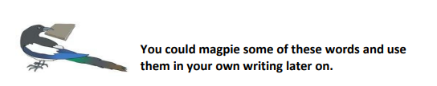

Slide 6
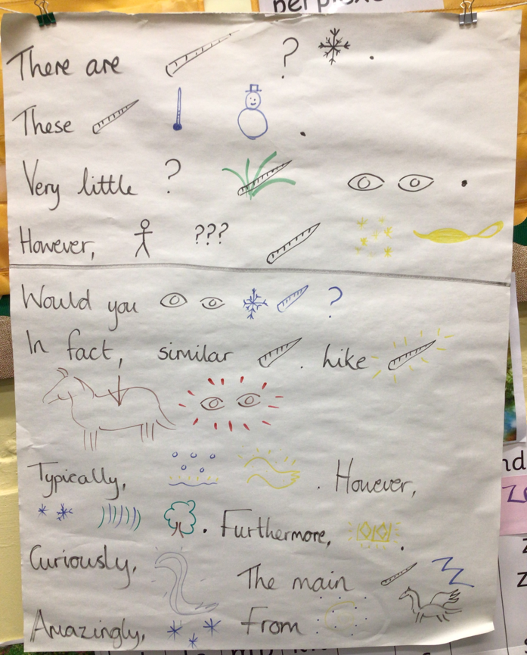
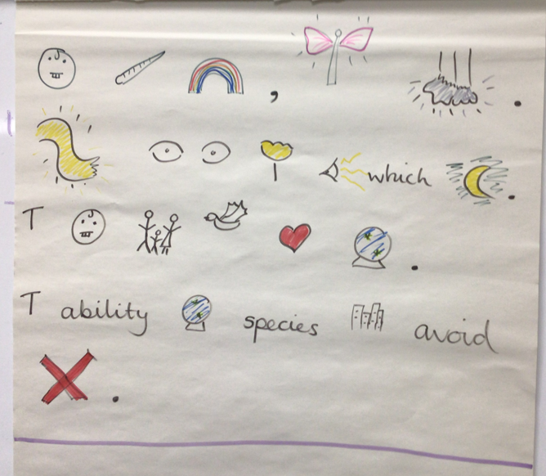
The Frost Unicorn

Slide 7


Slide 8
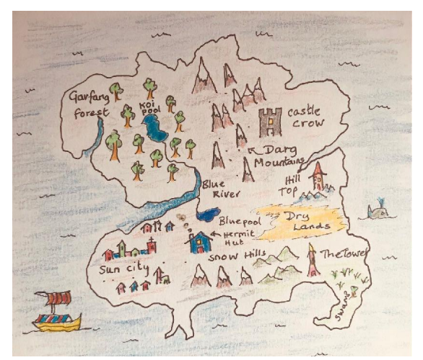
Activity 3: Where do frost unicorns live?
Mark the spot where you think frost unicorns are most likely to live. Give three reasons for your answer. One has been done for you.
Reason 1 – Frost unicorns are likely to live in the Snow Hills because they are close to the Blue Pool, near the town and the sea is nearby.
Reason 2 –
Reason 3 –
Reason 4 –

Slide 9
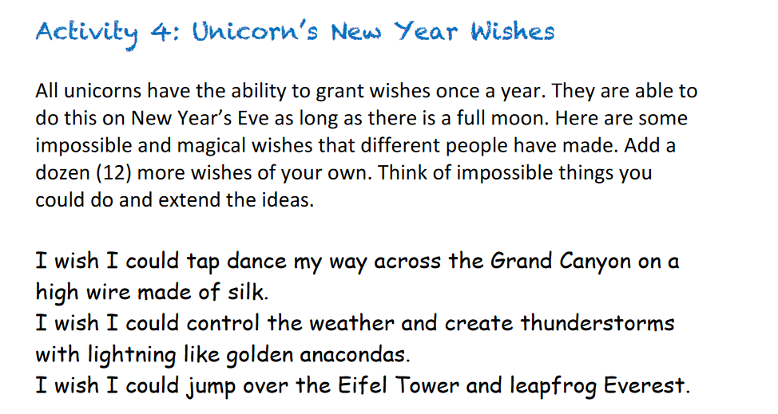

Slide 10


