Slide 2
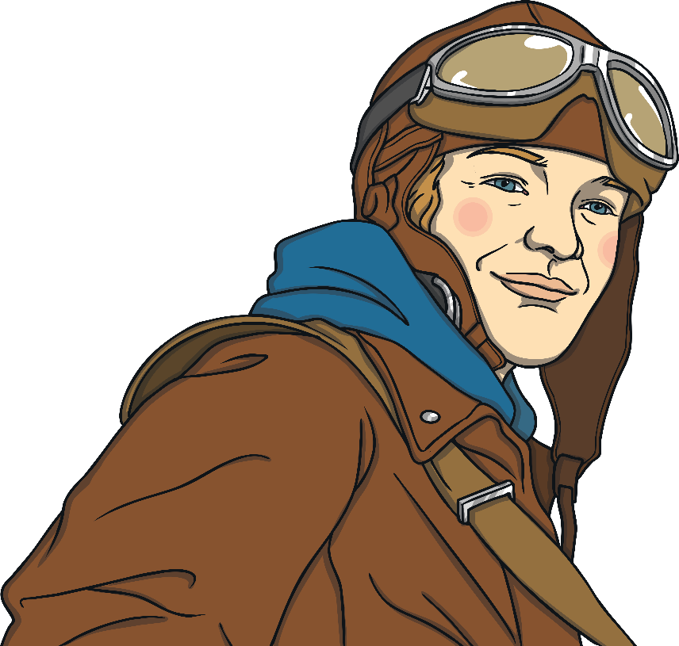
Who Was Amelia Earhart?
Amelia Earhart was an American
aviator.
She flew planes and explored different
parts of the world by plane.
Amelia Earhart is one of the world’s most important aviators. She was the first woman to fly across the Atlantic Ocean by herself.

Slide 3
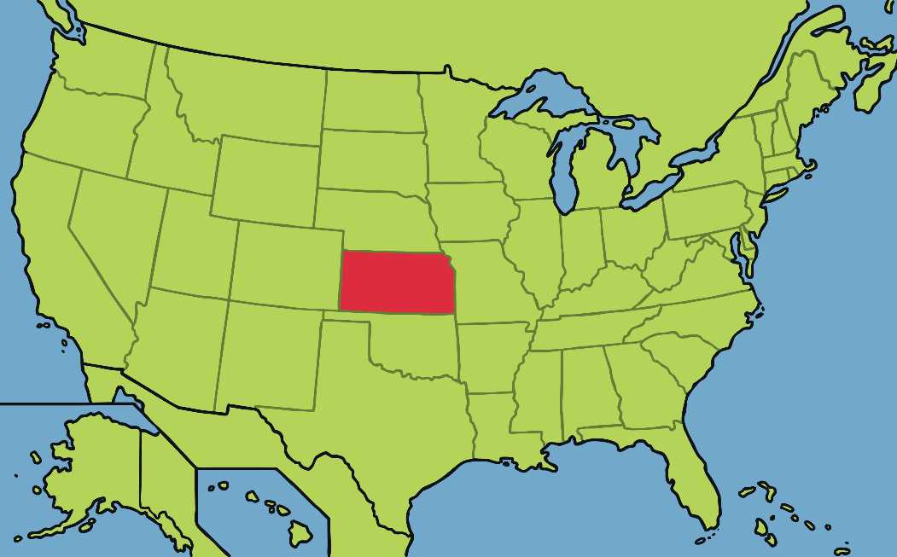
Amelia’s Childhood
Amelia Earhart born in Kansas, United States on 24th July 1897.
Kansas
She enjoyed adventures and did not behave the way girls were expected to at the time. She and her younger sister, Muriel, would climb trees, hunt rats and ride their sledge down hills on their tummies!

Slide 4

Freedom
Unusually for this time, Amelia and her sister were allowed to wear bloomers, which the other girls in the neighbourhood were not allowed to do. It was not thought to be very lady-like to wear bloomers.
They enjoyed the freedom to have adventures that they did not have when wearing dresses.
Amelia’s mother encouraged her daughters to be different and not to do what was expected of young ladies at that time. Amelia was encouraged to be independent.

Slide 5
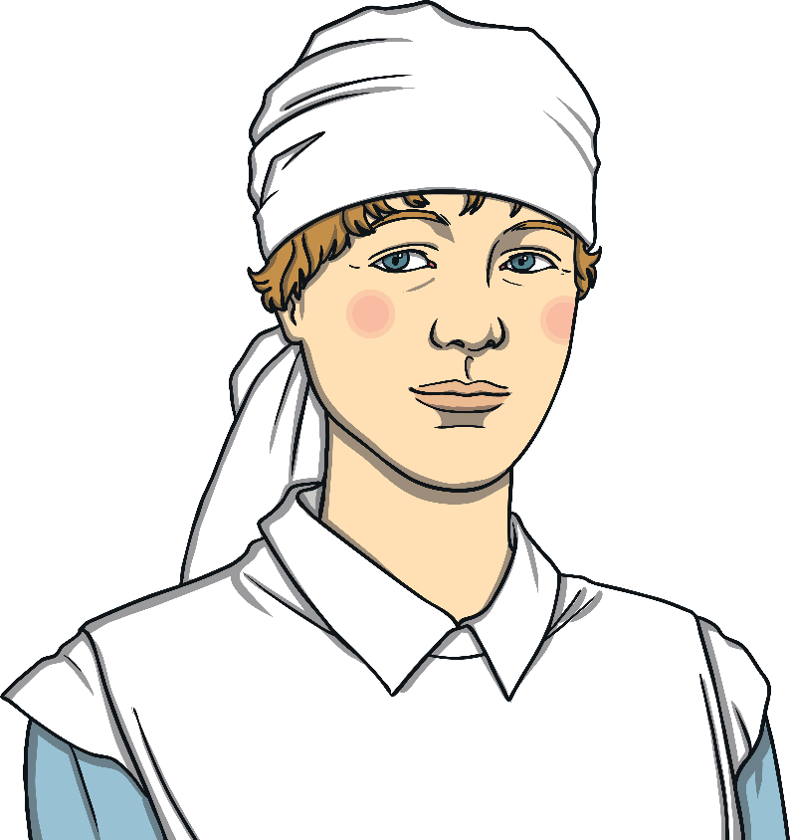
Amelia the Nurse
During the First World War, Amelia visited
her sister in Canada. While she was visiting,
Amelia became interested in caring for
wounded soldiers from the war.
In 1918, Amelia left college to become a nurse’s aide in
Toronto, Canada.

Slide 6
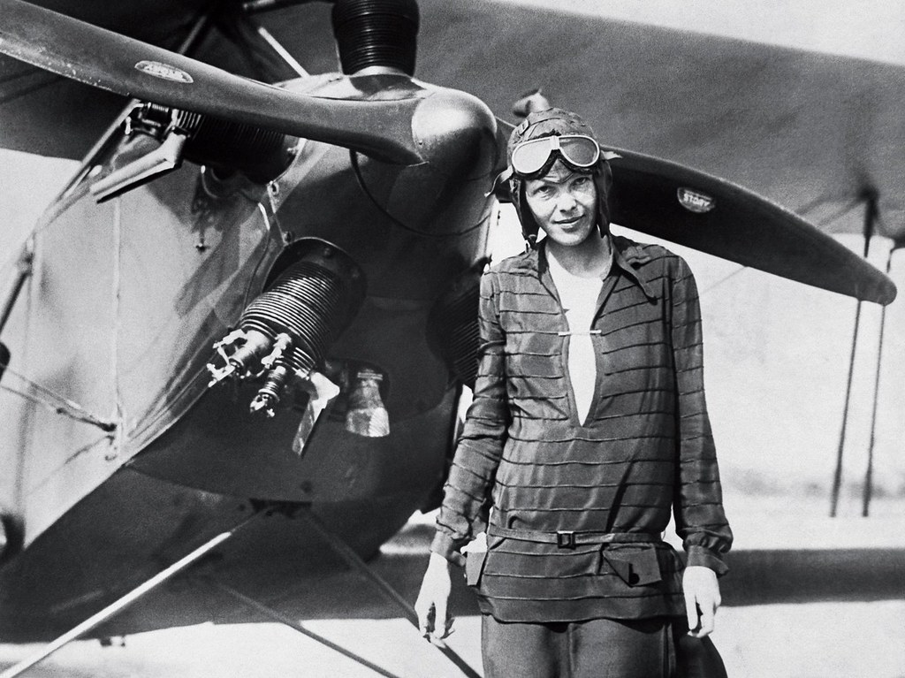
Amelia’s First Flight
Amelia took her first flight as a passenger on 28th December 1920. This flight inspired her to become an aviator and she had her first flying lesson aged 23.
In 1921, Amelia bought her first plane. Her plane was bright yellow and nicknamed the “Canary”.
In May 1923, she got her pilot's licence. Amelia was the 16th woman in the world to earn one.

Slide 7
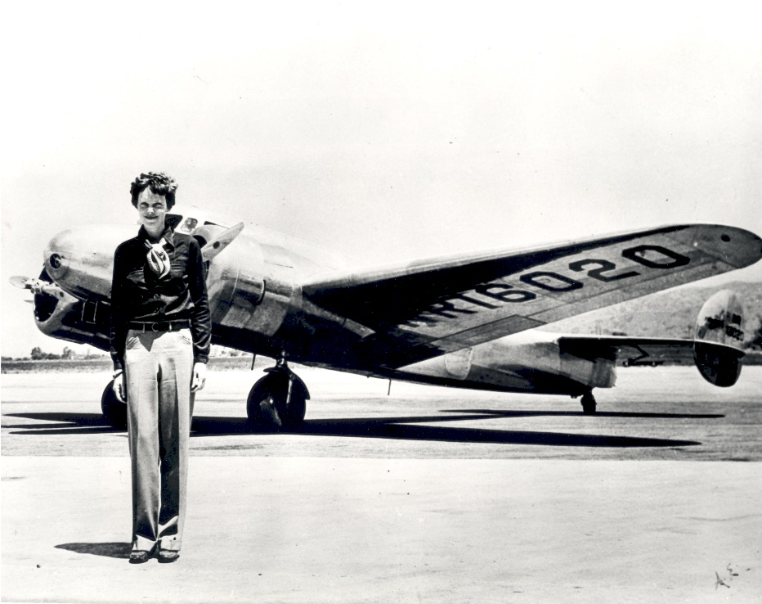
Record Breaker
In October 1922, Amelia broke
the women's altitude record.
In June 1928, she became the first woman to fly across the Atlantic Ocean as a passenger, alongside two other male pilots.
In May 1932, she became the first woman to fly solo across the
Atlantic Ocean.

Slide 8

Amelia’s Last Adventure
On 20th May 1937, Amelia and her navigator, Fred Noonan, left Oakland, USA and began her biggest adventure, to fly all around the world.
This would be a journey of
29 000 miles and was to end at the same place it had started, in the United States. The whole world was very excited as Amelia had become world famous due to her record breaking adventures.

Slide 9

Mystery Disappearance
On 2nd July 1937, Amelia and Fred Noonan tried to make the next flight of their trip, from New Guinea to Howland Island in the Pacific.
However, the weather was bad, with cloud and rain showers. The island they were hoping to land on, Howland Island, was extremely small, so two American ships (who were on the path they would be flying) were ordered to burn every light to act as markers to guide them in.
Sadly, Amelia and Fred never made it to Howard Island.
They were low on fuel and the weather was very poor.

Slide 10
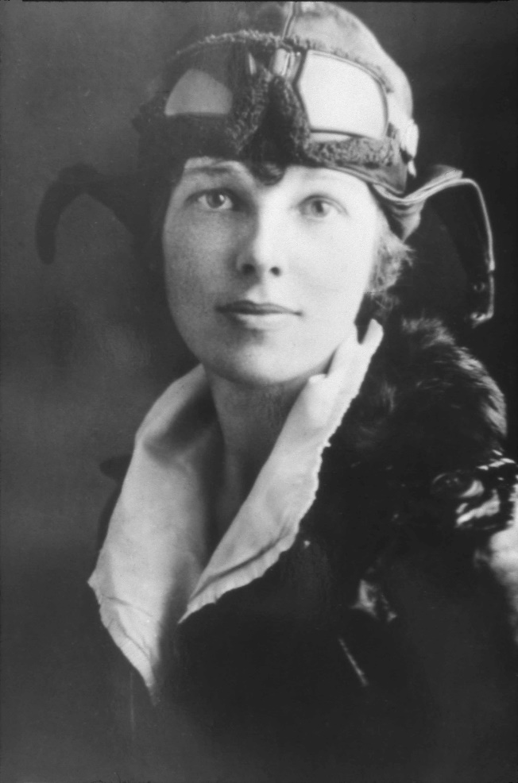
What Happened to Amelia Earhart?
Amelia Earhart and Fred Noonan were never found or heard from again. Searches were made but no traces of the plane or its passengers were ever found.
Amelia was declared dead in January 1939. No one knows for certain what happened.
It will always be a mystery what happened to Amelia Earhart.

Slide 11
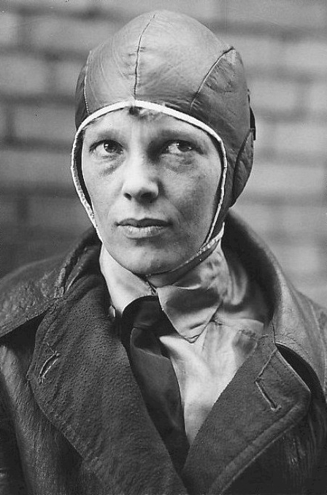
An Important Legacy
Amelia wanted to be adventurous and brave in her life, even when she was scared or frightened.
She believed you could achieve anything you put your mind to, so long as you worked hard for it and never gave up.
She is an important figure who reached for the skies and didn’t listen to anyone who said she shouldn’t because she was
a woman.

