Slide 2
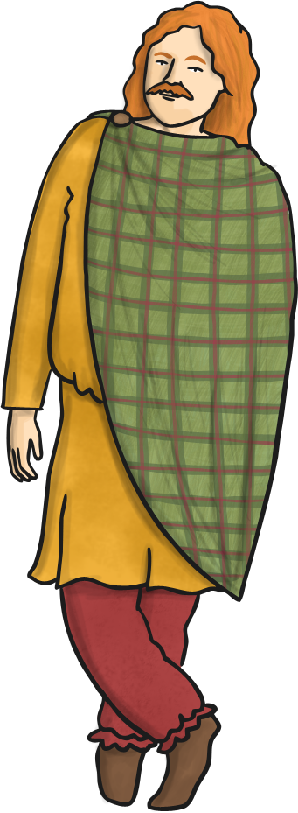
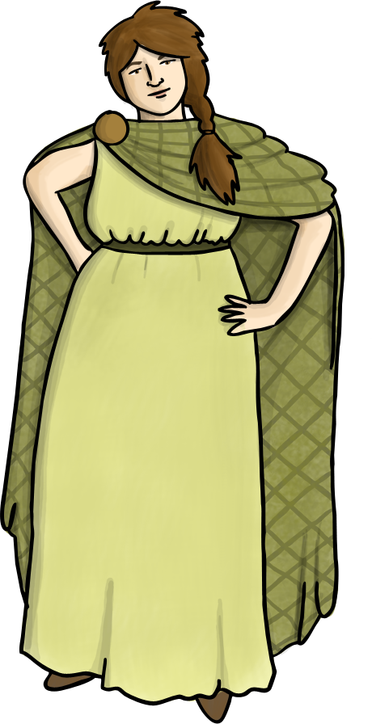
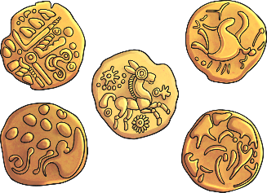

Who Were the Celts?
The Iron Age Celts lived in Britain and Ireland from 750BC until 43AD.
They came from all over Europe, from Austria and Switzerland to Southern France and Spain.
The word Celt comes from the Greek word Keltoi
although its definition is unclear.
750 BC means the Celts were in Britain 750 years before Jesus was born.

Slide 3
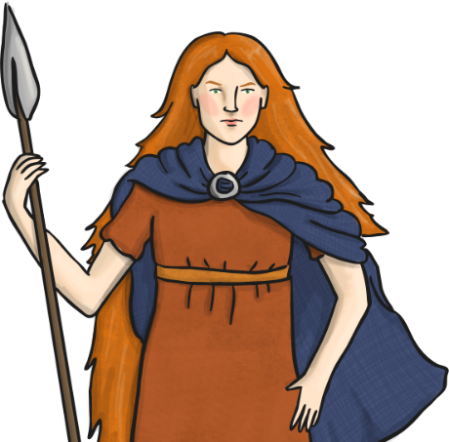
Tribes
Celts were part of tribes (different groups), and each tribe had their own king or queen. This meant there was a lot of fighting between neighbouring tribes.
There were three main Celtic groups:
The Gauls
The Britons
The Gaels
Famous Queen Boudicca:
Boudicca was queen of the Iceni tribe. She was described as tall with thick, red hair, and wore a bright tunic and a cape pinned with a brooch. She brandished her sword as she rode a chariot, and she hated the Romans.

Slide 4
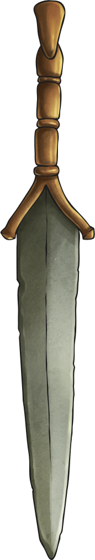
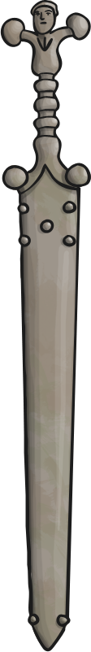
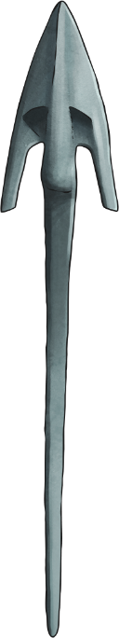
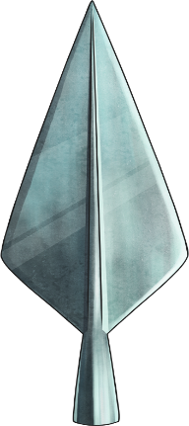
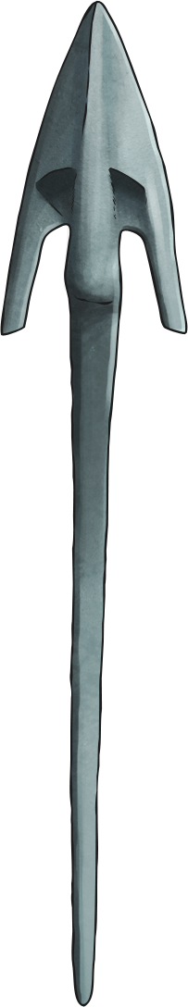
Iron Age Celts
The Iron Age Celts are called this because they discovered iron and became great craftsmen who created weapons and household objects from this new metal. Before that, bronze was the main metal that items were made from.

Slide 5
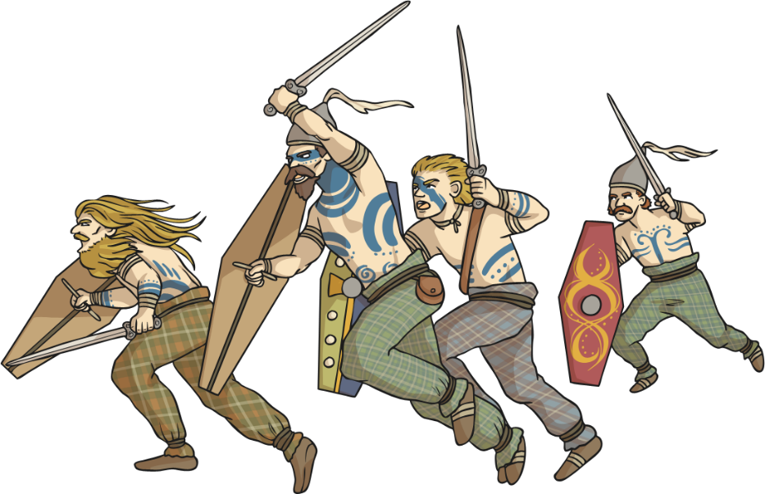
Warriors
The Celts were fierce warriors. They did not wear armour and instead often fought naked, and painted their bodies with blue patterns to frighten their enemies. This paint was called woad.
They had large shields covered in animal hide, and held long spears made from iron, which they swung around their heads. They also fought with spears and daggers.

Slide 6
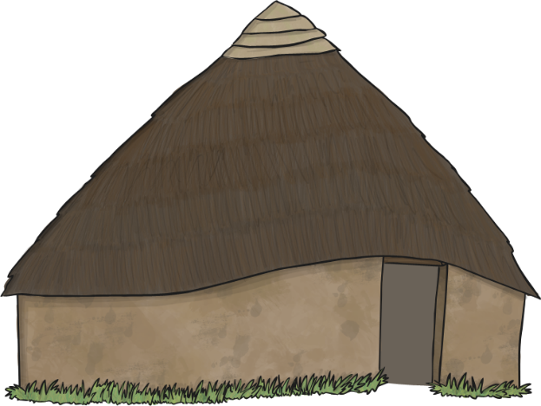
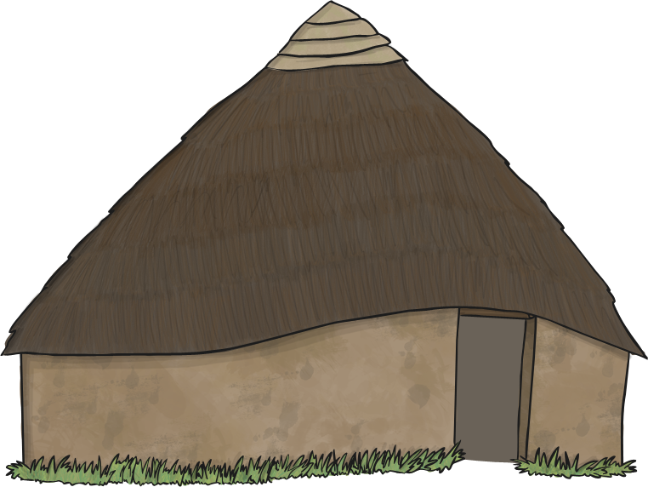
Homes
The Celts lived in roundhouses. These were made from wattle and daub – a mixture of straw, wood and mud.
There would be a fire in the middle of the house, which was one large room, and the smoke escaped
from a small hole in the roof. There were no
windows, as they needed to keep the heat in.
The roof was made from straw thatch.
Houses were often built near each other on top of hills which were called hillforts. This was for security and to help defend their territories.

Slide 7
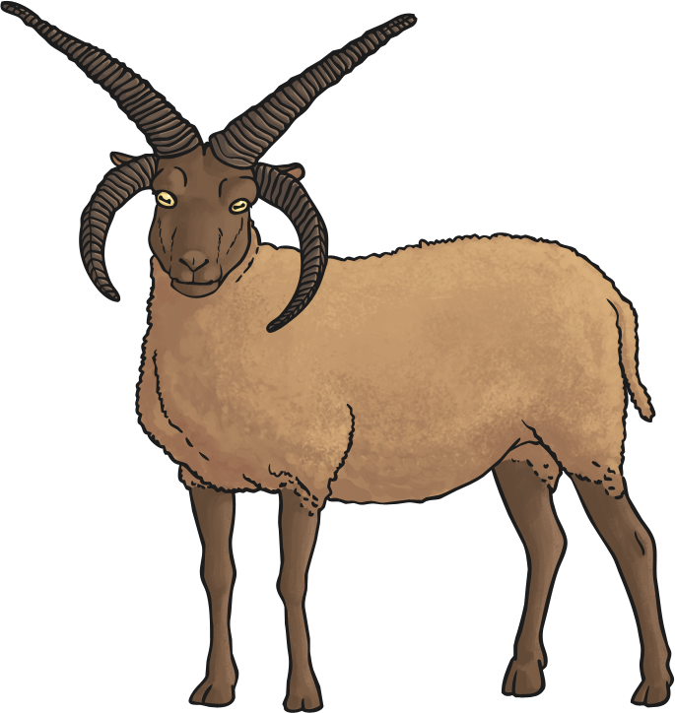
Livelihood and Food
The Celts were mainly farmers. They grew corn, gathered berries, nuts, plants and hunted animals. They ate deer, bear, wild boar and fish. They collected honey and eggs.
They kept cows, pigs, goats and sheep. A farmer had to be ready to defend his land and fight when he had to!

Slide 8
Clothes
The Celts loved brightly coloured clothes. They wore woollen clothing which they dyed with natural dyes. They used the juice from berries and plants, and wove the wool using a loom. They used metal or bone needles to sew pieces together.
The women wore skirts or dresses to the floor, with a cloak pinned with a brooch.
The men wore T-shaped tunics with a belt and trousers.

Slide 9
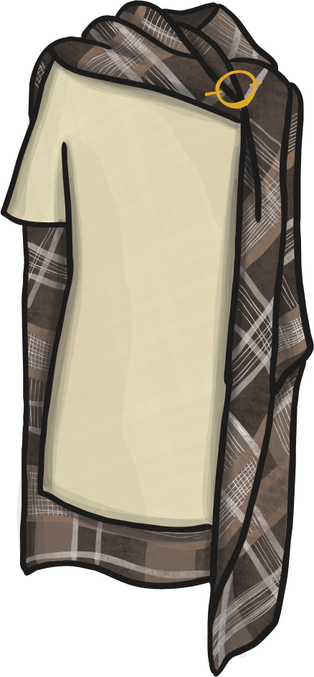
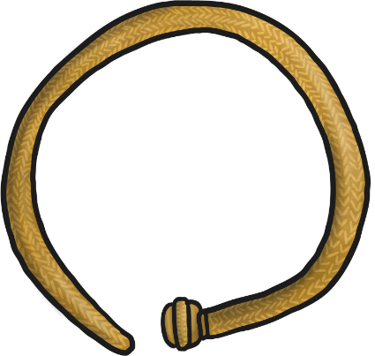
Jewellery
The Celts liked their jewellery. Jewellery was made from bronze, gold, silver, coral and tin.
The important people, like chieftains, would wear a gold torc which was a twisted neckband.
Brooches were used to pin cloaks together.

Slide 10
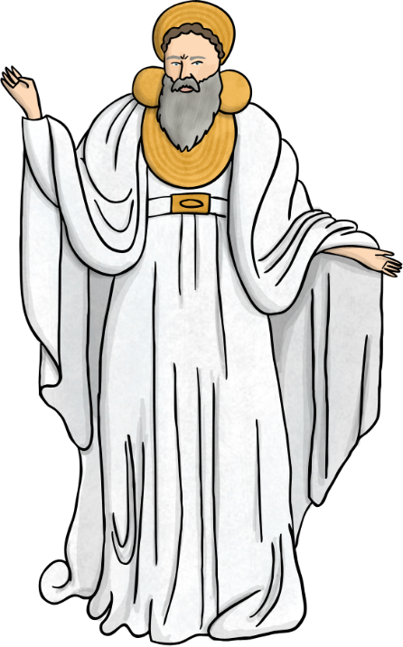
Religion
The Celts believed in over 300 gods and goddesses. They made animal sacrifices to the gods, which meant they killed animals as a gift to the gods. They would throw weapons into rivers and lakes to please the gods, and bring good luck.
Druids were the Celtic priests. They could tell the future by studying nature. They used the stars for guidance and made links between the natural world and the next life.
Celts believed there was a life after death so they were buried with their possessions as they believed they could take them with them.

Slide 11
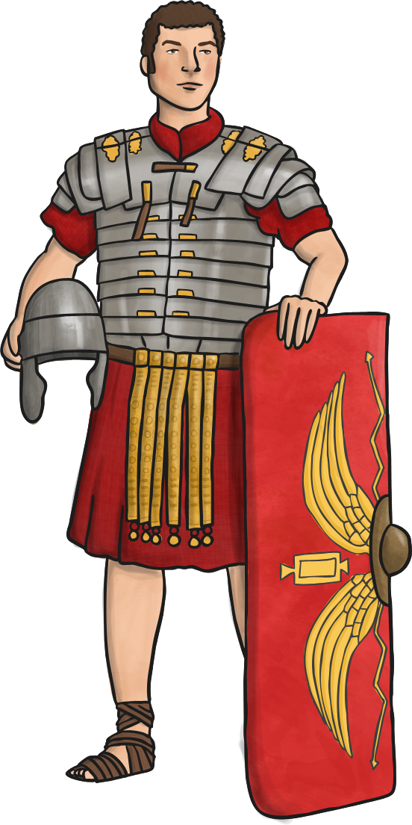
Roman Invasion
The Romans put an end to Celt rule by invading Britain. They came from Italy and invaded in search of treasure, wealth and land. They were orderly and disciplined and the Celts were not.
Romans reported the Celts as having a hot temper and quarrelling a lot. This meant it was relatively easy for the Romans to invade and rule Britain.
The Celts and Romans lived alongside each other for many generations.

