Slide 1
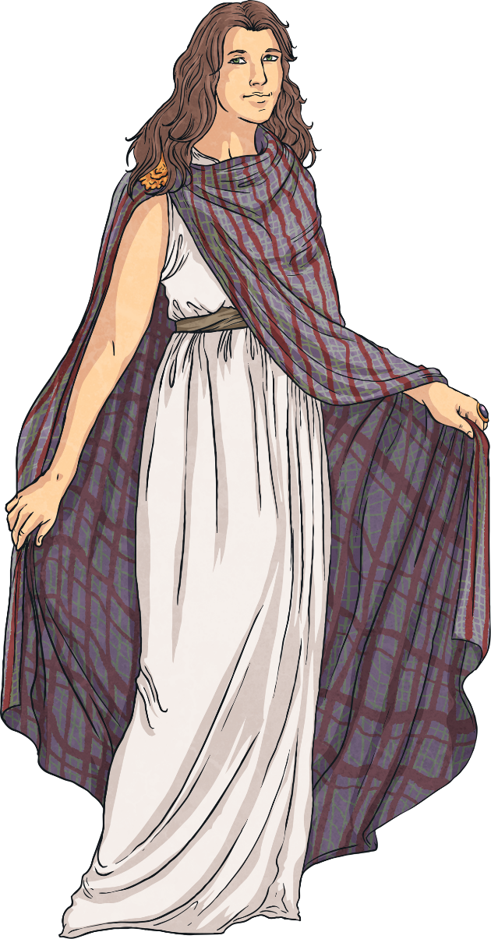
Who Were the Celts?
The Celts lived across much of central and northern Europe during the Iron Age.
They were thought to have arrived in Britain around 1000 BC and ruled over many parts of it until the Romans arrived in AD 43.
The Celts were formed of many different groups,
known as tribes, and each tribe had their own
kings and queens. However, despite being part
of separate tribes, their cultures, traditions and
religious beliefs were similar.
Did You Know…?
The word ‘Celt’ has only been used since the 18th century. The Ancient Greeks referred to them as ‘Keltoi’ and the Romans called them ‘Celtae’ or ‘Galli’, meaning barbarians.
barbarians – People in ancient times who didn’t belong to the Greek, Roman or Christian civilisations.

Slide 2
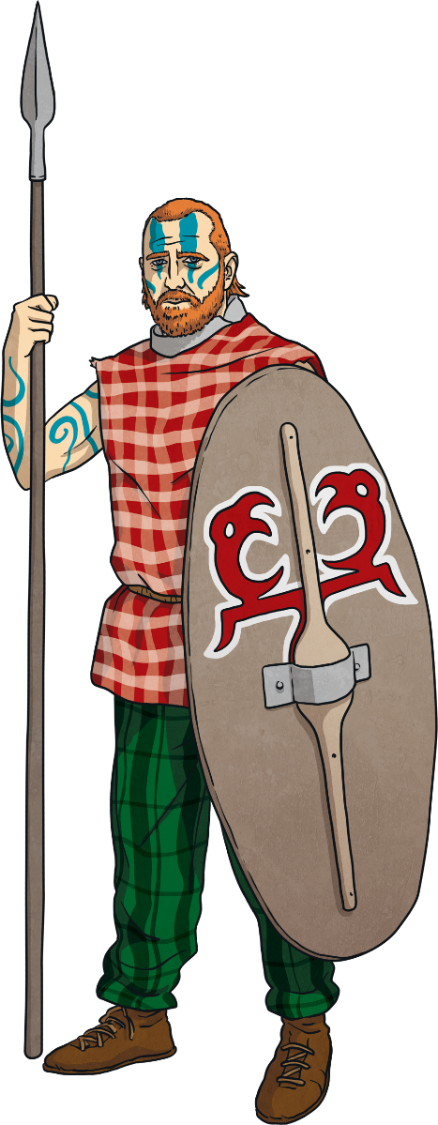
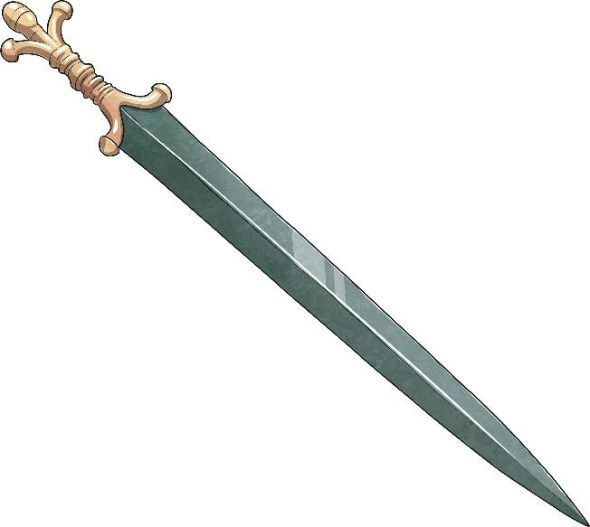
Why Were They Known as Warriors?
As well as fighting other civilisations, the Celts would often fight against other Celtic tribes for land and resources.
The Celts did not write down a lot of information about their time period. Most of what we know about them comes from the Romans and Ancient Greeks, who battled against Celtic tribes. It is also possible these sources are biased, as the Romans and Greeks wanted to be seen as more civilised than the Celts.
Being a successful warrior was an important part of Celtic culture; those who fought well in battles were treated better by their community and often given better food and places to sit during feasts.
biased – To make an unfair judgement of someone or something because of personal reasons.

Slide 3
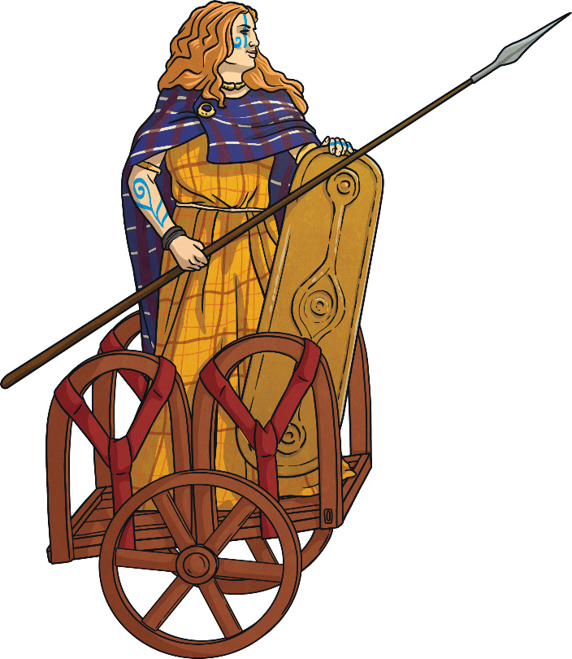
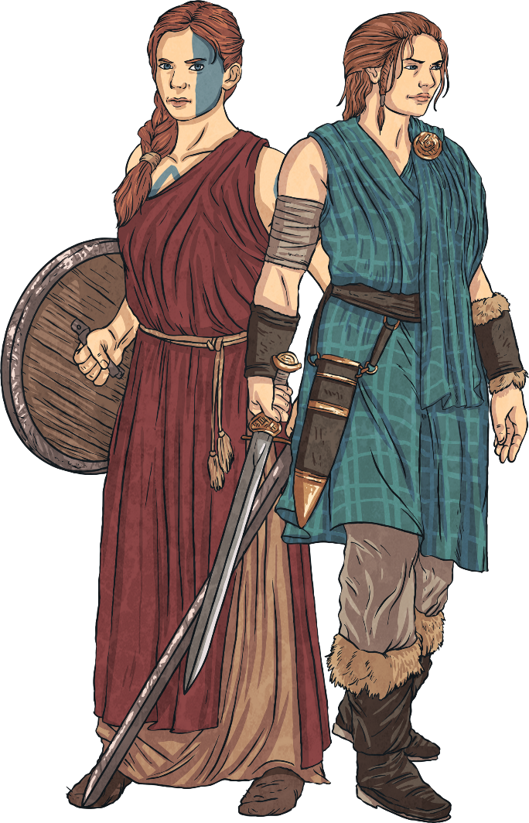
Female Warriors
Unlike many other civilisations, it wasn’t just males who fought in battles. Celtic women could decide to train as warriors. The Celtic queen Boudicca led an entire army against the Romans.
Some Celtic stories also feature two warrior sisters called Scáthach and Aífe. According to legend, they each had their own training schools where they taught some of the fiercest heroes of Celtic mythology.

Slide 4
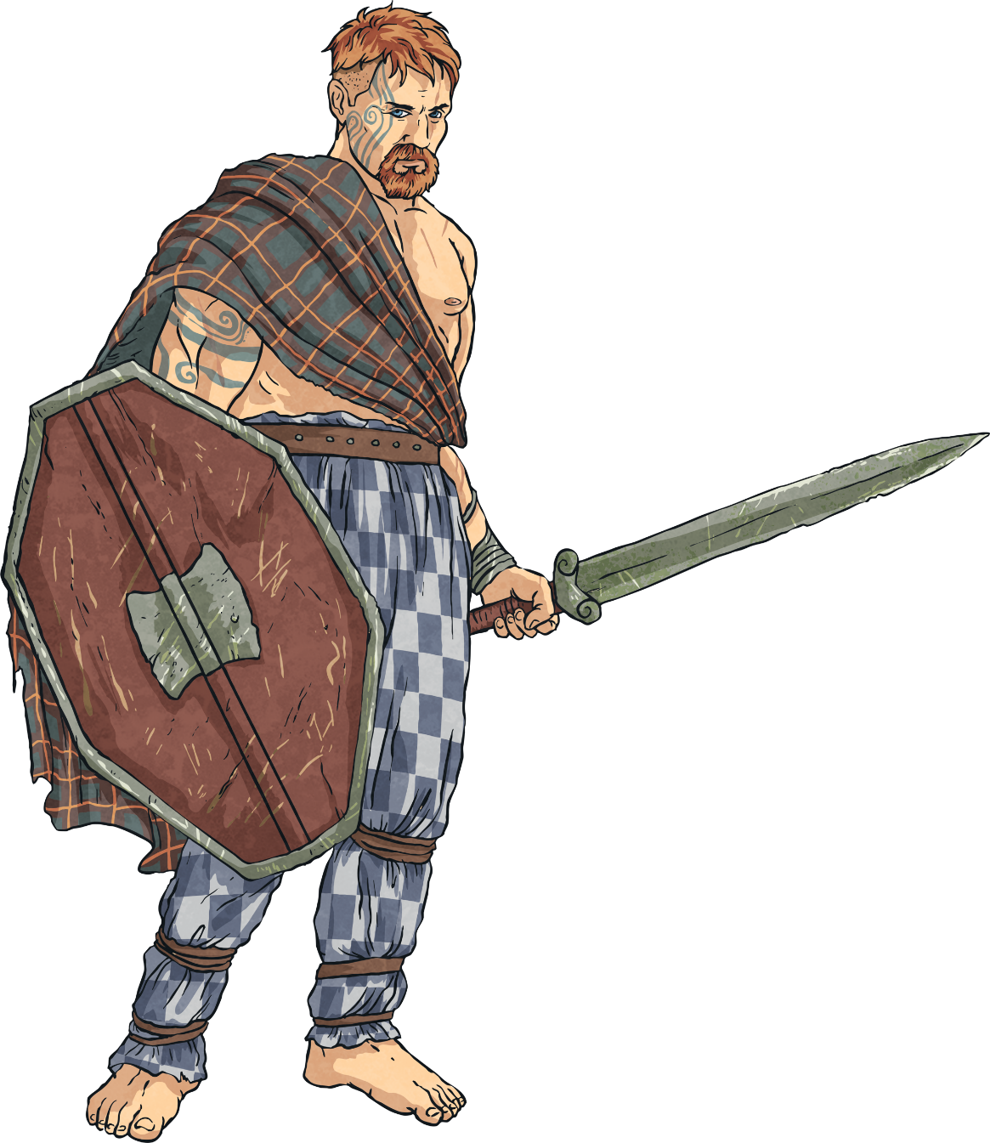
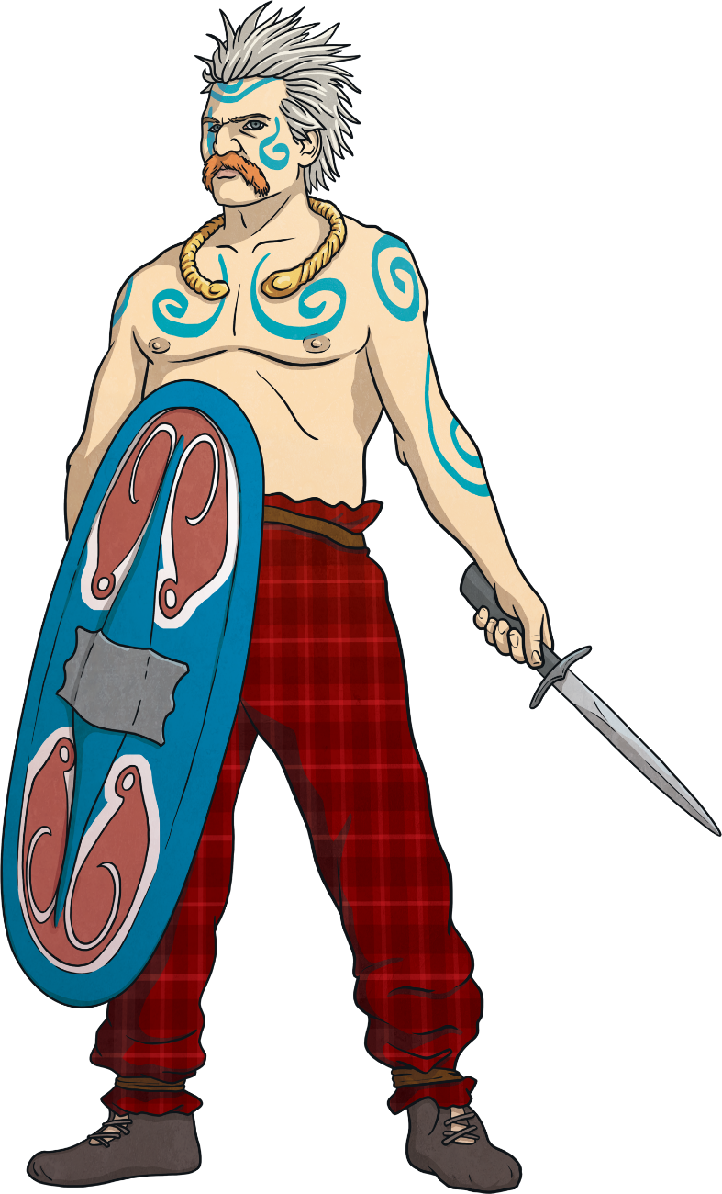
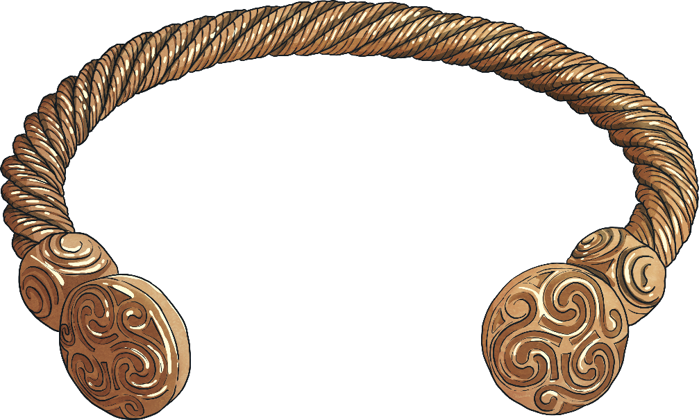
Appearance
More successful Celtic warriors would wear jewellery made of gold, bronze and iron to show their status. A popular piece of jewellery for Celts to wear was a neck ring, known as a torc. These were sometimes collected as battle trophies by enemy soldiers.
Many Celtic warriors wore checked tunics, cloaks and trousers (called bracae). It was also common for male warriors to have a moustache and spike their hair.
They were also known for using a blue dye called woad to paint designs on their face and body for battles. In addition to the painted dye, it is thought that they tattooed themselves too – sometimes with the designs of animals, which they thought gave them protection.

Slide 5
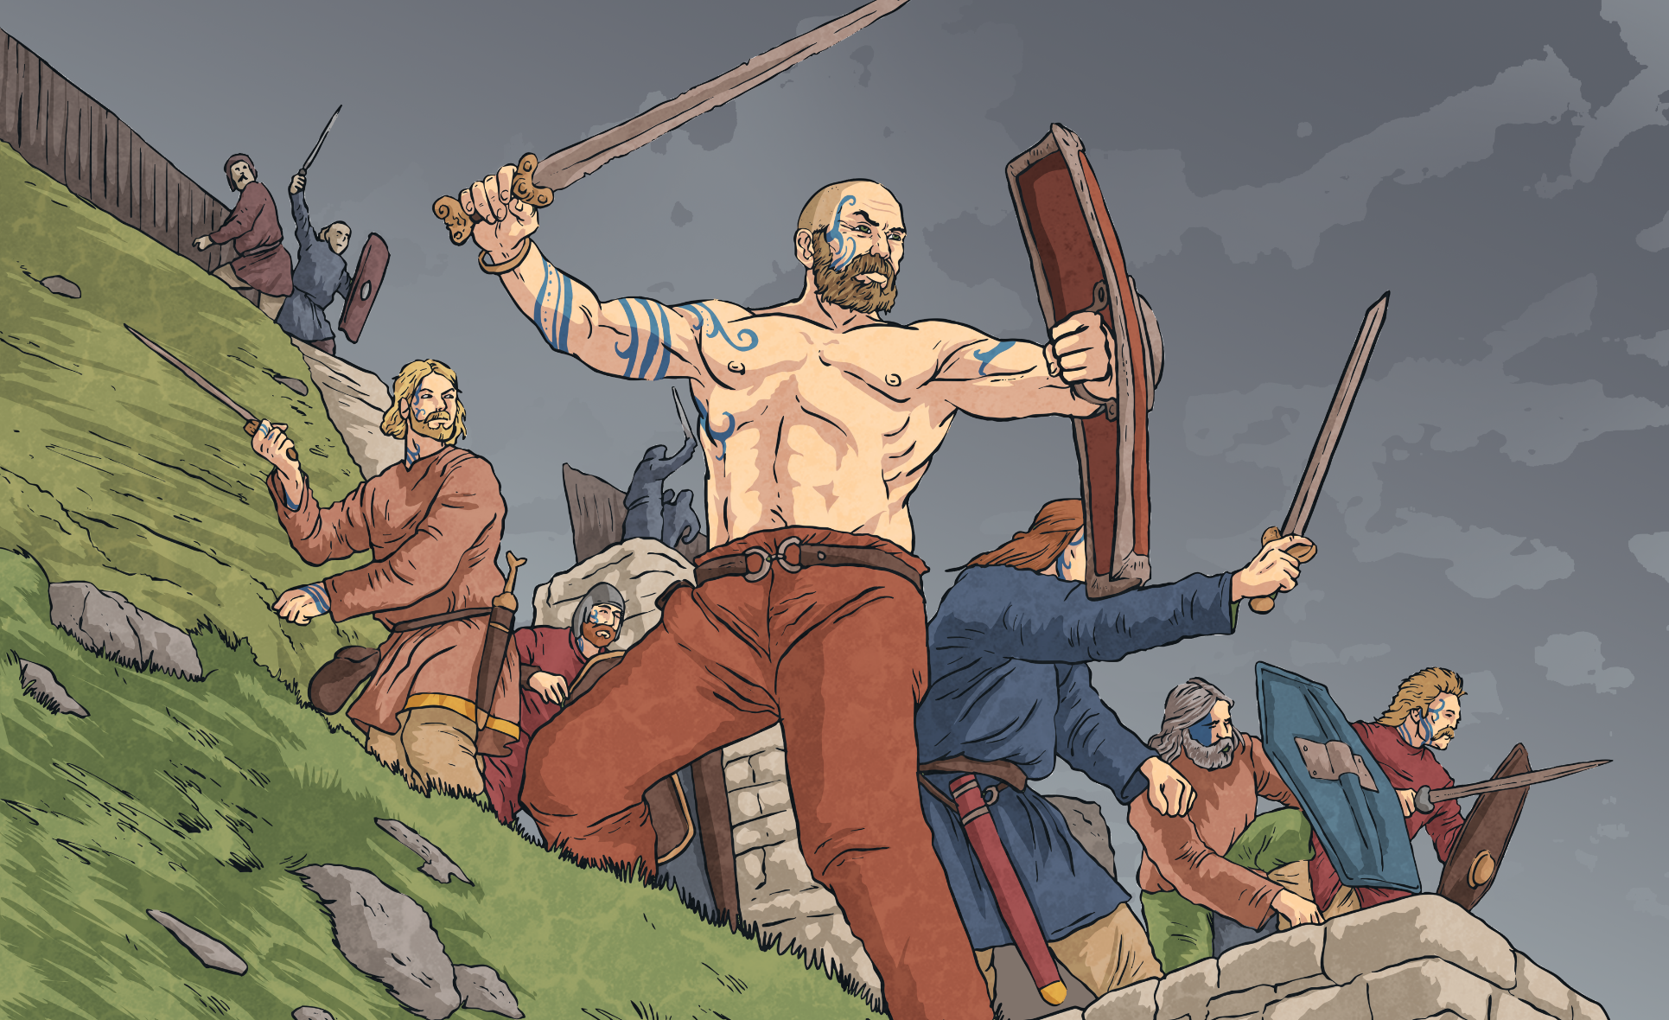
Did You Know…?
Some Celtic warriors fought without any clothes.
It is not known exactly why they did this but one reason suggested is that it made them look more intimidating.
Other reasons include that it prevented wounds from being infected by dirty clothes and that it gave them more freedom to move in battles.

Slide 6
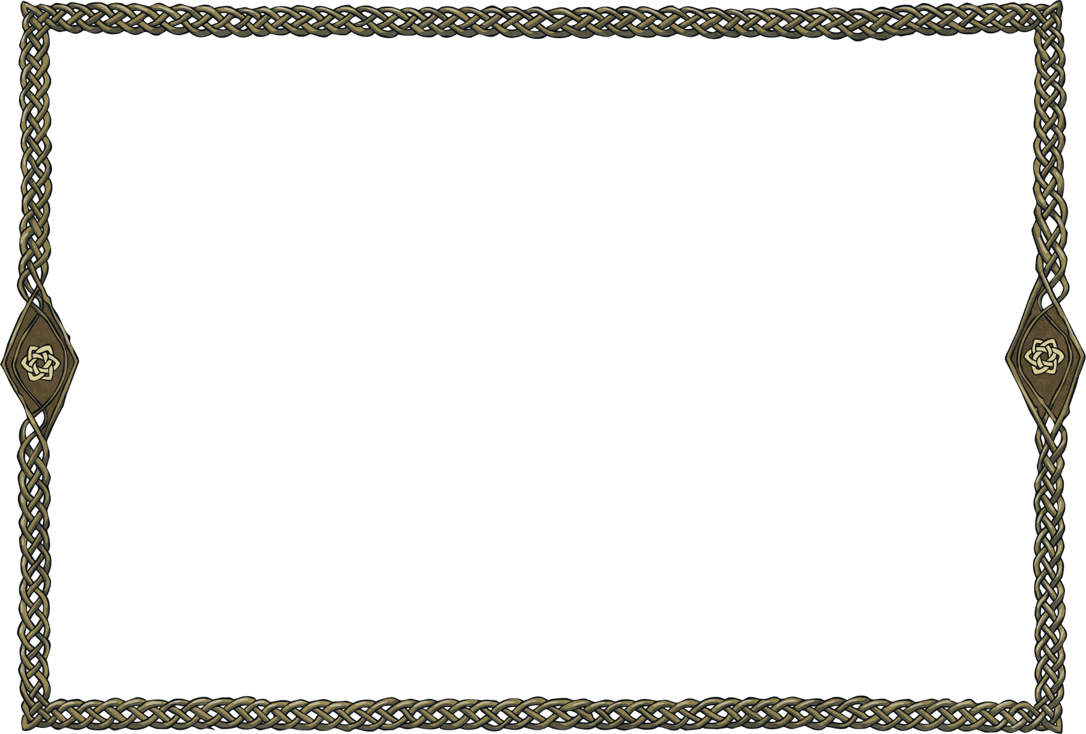
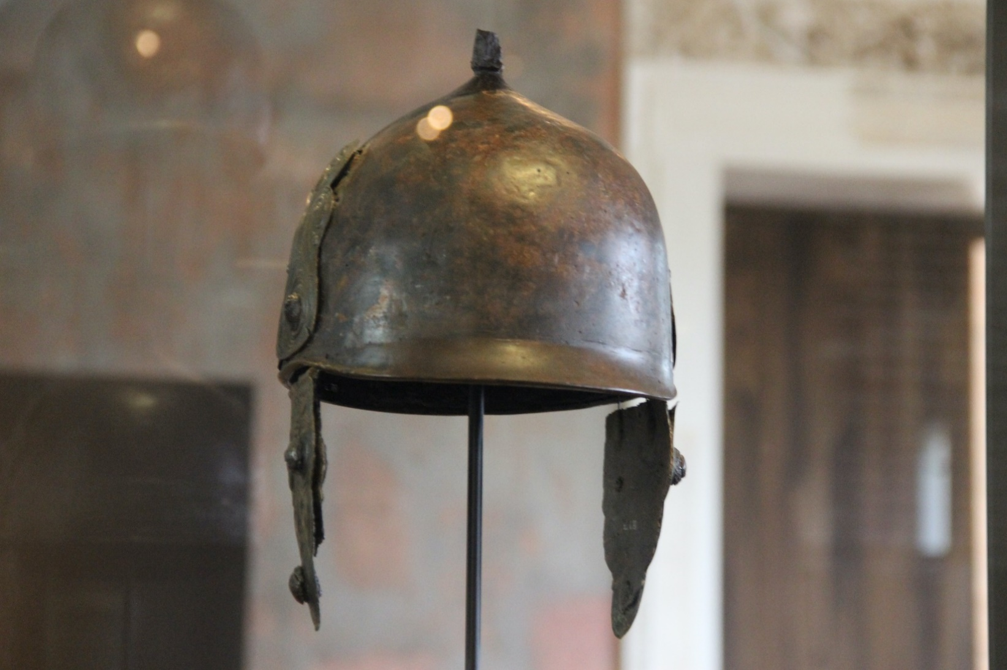
Shields and Armour
Celtic shields were often round or oval and made out of wood. They were then covered in leather and were sometimes decorated with religious symbols.
Armour was only used by the highest-ranking warriors. It could include breastplates made of metal or stiffened leather or vests made of chainmail.
Celtic helmets could be quite different in appearance but were often cone-shaped or included cheekpieces to protect the face. One surviving Celtic helmet even featured a small bird on top, which had wings that would flap as the soldier ran.

Slide 7
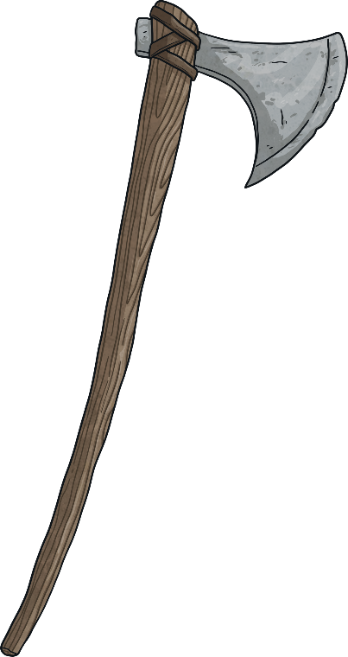
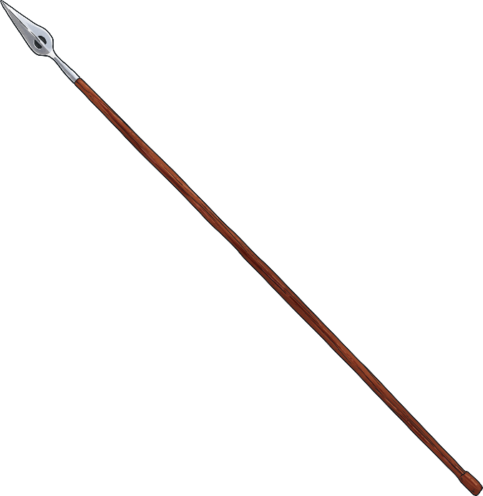
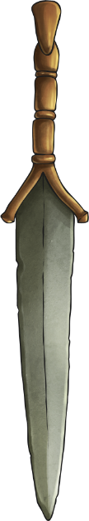
Weapons
During the Iron Age, Celts began to make their weapons out of iron instead of bronze as it was a stronger material.
Celtic warriors used a range of weapons, including swords, spears and axes. Their main weapon of choice was usually a sword; however, daggers and javelins were popular weapons for them to use in battles. This was because they were easier to carry and make but were still sharp.
dagger
axe
javelin (or spear)

Slide 8
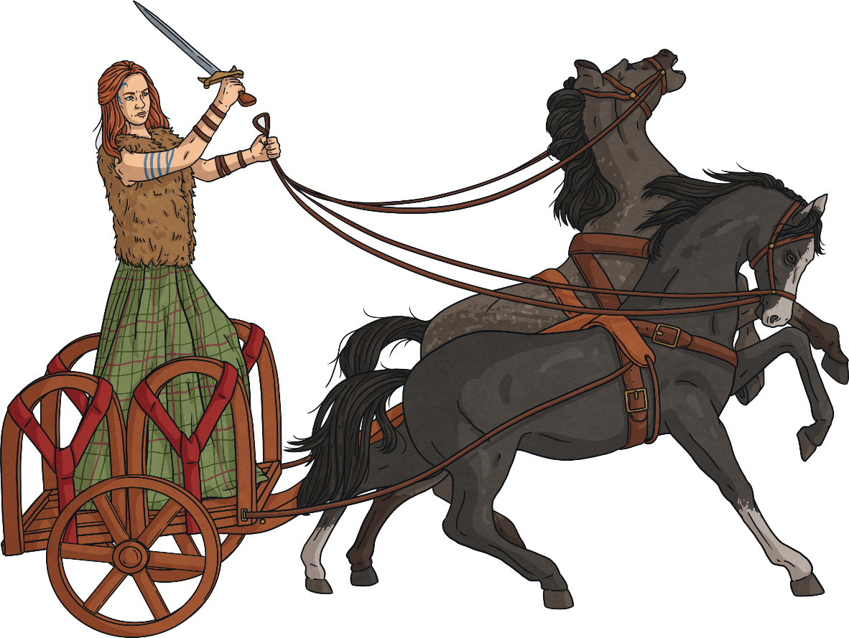
Chariots
The chariots were made of wood and had two wheels. The floor of them was often made of wicker or leather as they were lighter materials and meant the chariot could travel more quickly.
Most Celtic soldiers fought on foot. However, sometimes horses and chariots were also used in battle.
Chariots were thought to be mainly used to get warriors right into the centre of the battle, to chase a fleeing enemy or for speed during an ambush.
ambush – To attack an enemy by surprise.

Slide 9
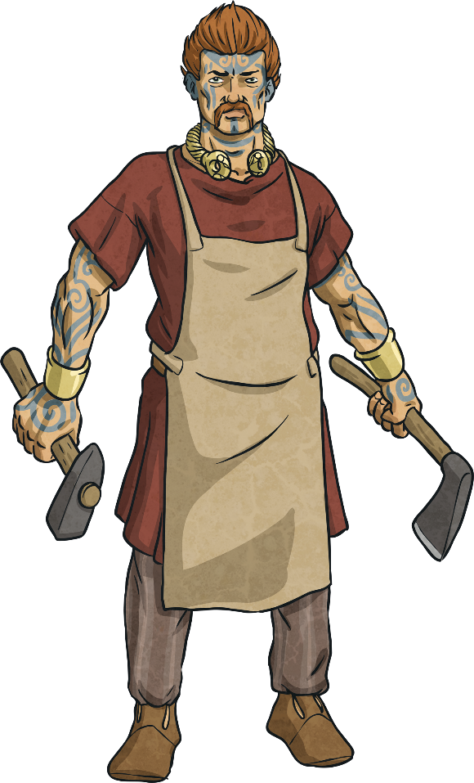
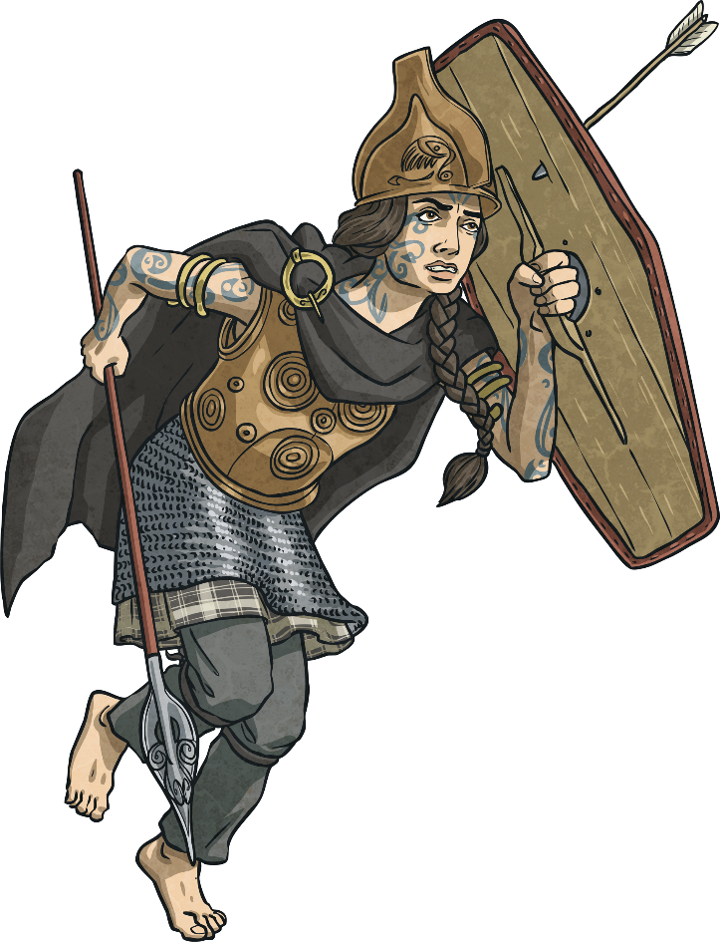
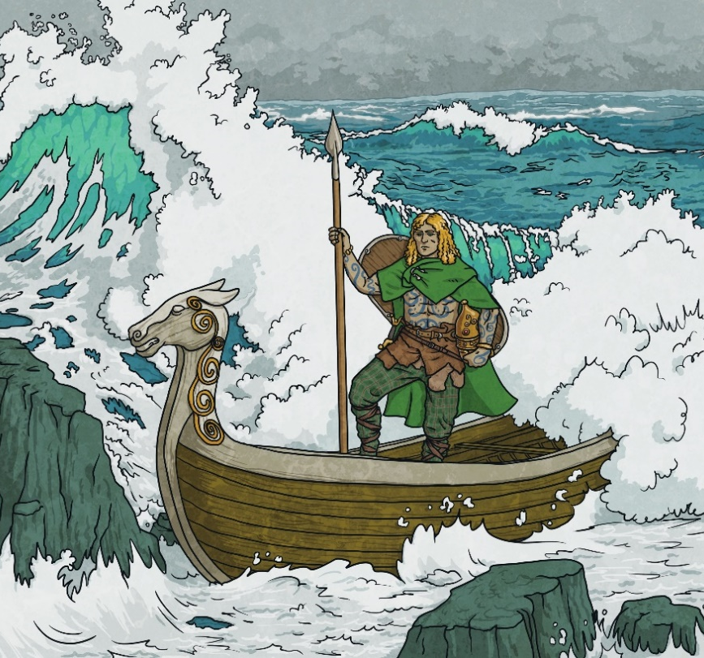
Celtic Warrior Gods and Goddesses
Like many other civilizations at the time, the Celts worshipped gods and goddesses that represented war and battles. Some of the most important Irish Celtic gods included:
Lugh – God of sun and light. He was viewed as a great warrior and was often called Lugh Lámfada, which meant long-armed and referred to his ability to throw weapons.
Badb Catha – The goddess of war, whose name means ‘Battle Raven’. She was thought to use magic to confuse enemy soldiers.
Goibhniu – The god of blacksmiths and weapon-making.

Slide 10
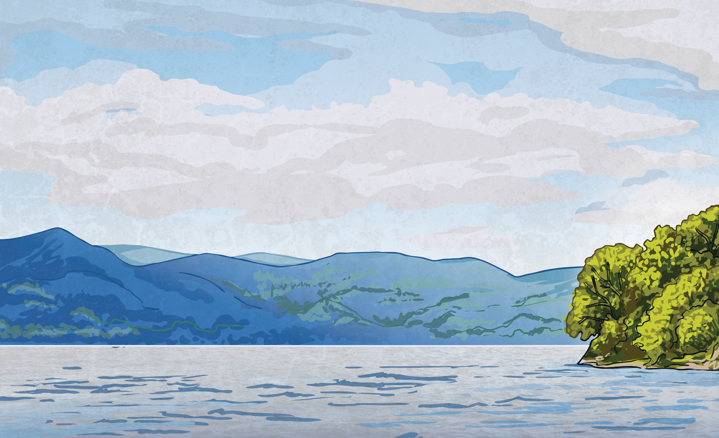

Did You Know…?
Many Iron Age weapons found by archaeologists have been located in rivers and lakes. This is because Celts would throw their weapons into bodies of water as a sacrifice to their gods and goddesses.

Slide 11
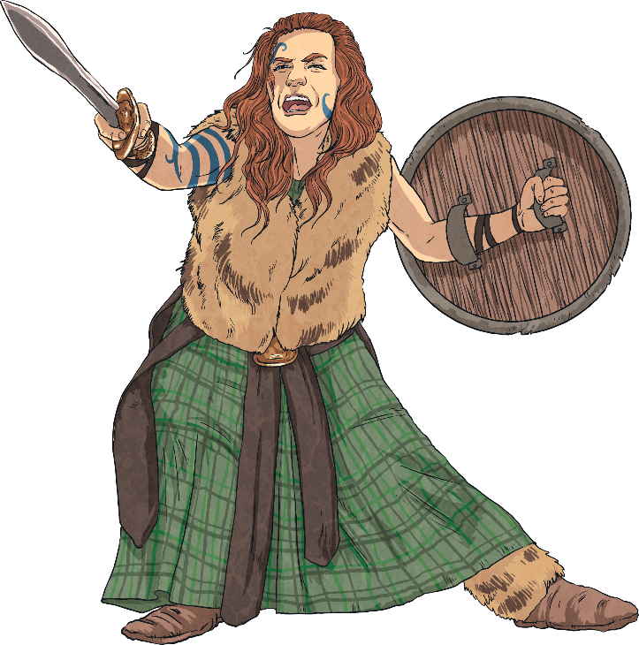
Famous Celtic Warriors
Boudicca – Queen of the Iceni tribe. When the Romans tried to take her tribe’s land, she burned down the Roman towns of Colchester, St Albans and London. She was defeated by the Romans in the Battle of Watling Street around AD 60-61.
Caractacus – Another tribe leader who fought against the Romans. He was king of the Catuvellauni tribe of Hampshire and Gloucestershire and led the resistance against Roman invasion between AD 43 and AD 47.
Venutius – Venutius was married to Queen Cartimandua, who betrayed Caractacus to the Romans. He then led a rebellion against Cartimandua and the Romans and took her kingdom for himself.

